Slide 1
ANALYSIS OF SOCIETY OPINION ON WOMEN SAFETY THROUGH SOCIAL MEDIA PLATFORMS
under the GUIDElines of a.uday kiran
B.SAI KUMAR-197R1A05C9
G.SRIKANTH-197R1A05E0
J.SAINATH REDDY-197R1A05E2

Slide 2
Abstract
Women and girls have been experiencing a lot of violence and harassment in public places in various cities starting from stalking and leading to abuse harassment or abuse assault.This project basically focuses on the role of social media in promoting the safety of women in Indian cities with special reference to the role of social media websites and applications including Twitter platform Facebook and Instagram and some other newly introduced social media platforms. There exists several opinion-oriented information gathering and analytics systems that aim to extract people’s opinion regarding different topics.The raw data is picked up from Kaggle website.

Slide 3
Existing system
People often express their views freely on social media about what they feel about the Indian society and the politicians. The tweets or comments about safety of women and stories of standing up against abuse harassment further motivates other women data on the same social media website or application like Twitter.
Earlier we used data mining techniques to extract data from twitter.The efficiency of this is very less.

Slide 4
Disadvantages
Twitter and Instagram point and most of the people are using it to express their emotions and also their opinions about what they think about the Indian cities and Indian society.
There are several method of sentiment that can be categorized like machine learning hybrid and lexicon-based learning.
Also there are another categorization Janta presented with categories of statistical, knowledge-based and age wise differentiation approaches .
The existing system helps only to express the views and there will be no actions taken on them.

Slide 5
Proposed system
As the efficiency of data mining in extracting is less,we proposing the new system by the combination of NLTK(Natural language toolkit) and NLP(Natural language processing).
NLTK is a platform used for building python programs that work with human language data for applying in statistical natural language processing.It contains text processing libraries for tokenization,parsing,classification and semantic reasoning.
(NLP)Natural language processing helps computers communicate with humans in their own language and scales other languages related tasks
NLP makes it possible for computers to read text, hear speech, interpret it, measure sentiment and determine which parts are important.

Slide 6
Advantages
Analysis of twitter texts collection also includes the name of people and name of women who stand up against abuse harassment and unethical behaviour of men in Indian cities which make them uncomfortable to walk freely.
The data set that was obtained through Twitter about the status of women safety in Indian society.
There will be quick punishments if the comment is very abusive.

Slide 7
Software requirement
Python
Django
MySql
MySqlclient
WampServer 2.4

Slide 8
Hardware requirement
Pentium IV or higher processor
256 MB RAM
minimum 512MB space in Hard Disk.

Slide 9
Novelty
The additional feature we are adding to this project is by using some selection algorithms we choose only selected data instead of total data in twitter so that we can able to decrease the time of analysis.

Slide 10
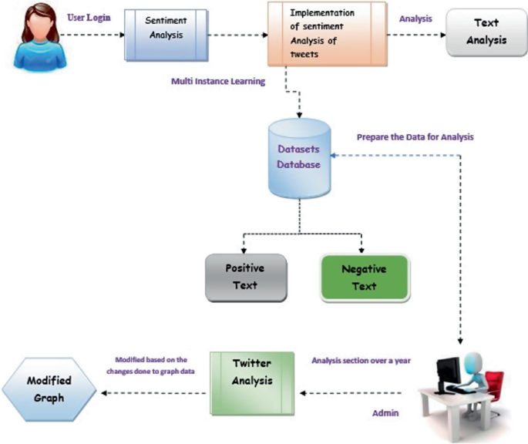
ARCHITECTURE

Slide 11
Modules
1)Data extraction: First step involved in analysis of sentiment is the collection of information from the social network website like twitter. This helps in extracting the tweet message but this message also includes extra data like tweets likes, dislikes and comments.we extract raw data from Kaggle website.
2)Text Cleaning: Once the data is extracted from the twitter source as the datasets, this information has to be passed to the classifier. The classifier cleans the dataset by removing redundant data like stop words, emoticons in order to make sure that non textual content is identified and removed before the analysis.
3)Sentiment Analysis: After the classifier cleans the dataset, the data is ready for the sentimental analysis process. Machine learning and Lexicon based learning and Hybrid are some of the approaches of sentimental analysis .The NLP is used for sentimental analysis.

Slide 12
4)Sentiment Classification: At this step, the dataset is ready for the classification. Each and every sentence of the tweet will be examined and opinion will be formed accordingly for subjectivity.Sentiments can be distinguished broadly into two groups – Positive and Negative.At this point of sentimental analysis,each of the subjective sentences which will be retained are classified into positive, negative and neutral.
5)Output Presentation: To measure the sentiment of the tweets in terms of Positive and Negative percentages, Bar graphs can be used. Similarly, to measure in terms of likes, dislikes, average length of tweet for a certain period, Time series can be used. To obtain the initial source of the tweet, pie charts can be used.

Slide 13
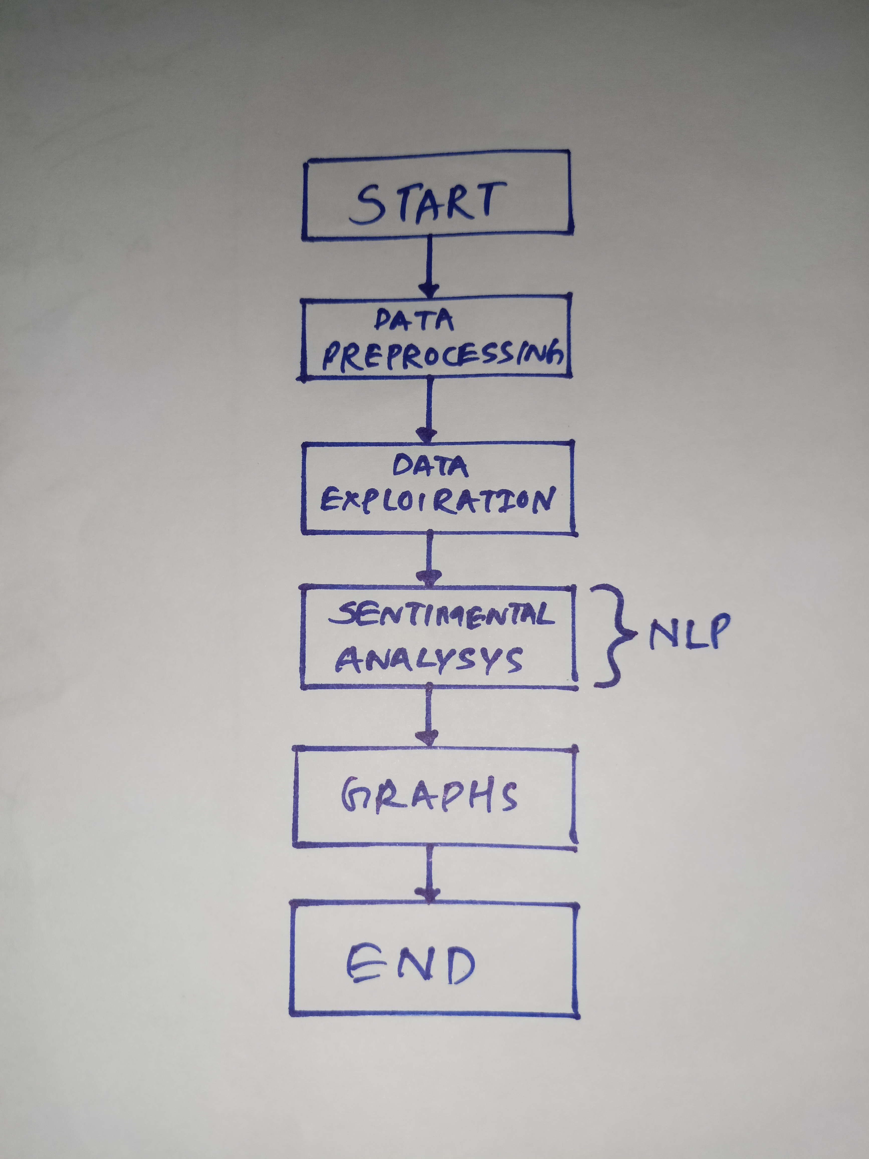
DATAFLOW DIAGRAM

Slide 14
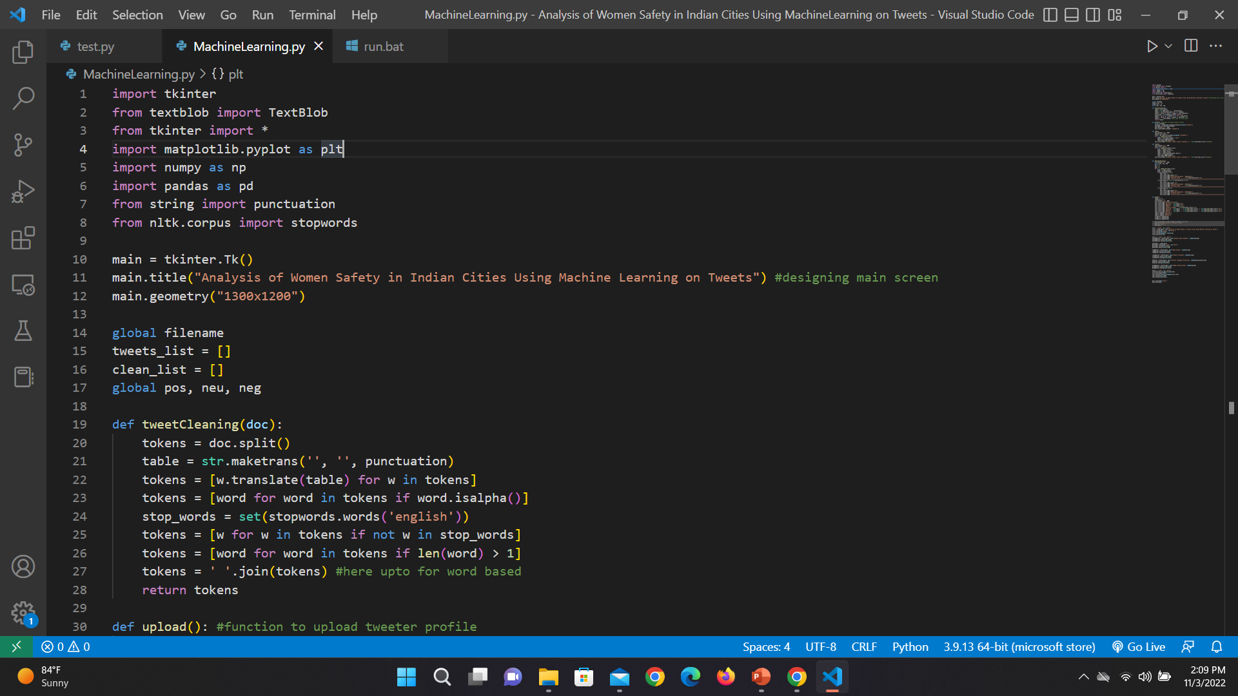
SAMPLE CODE

Slide 15
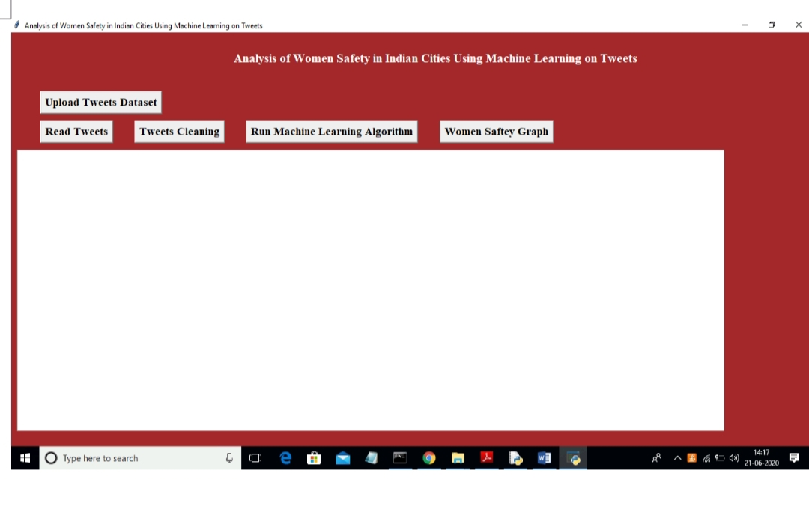
RESULT SCREENSHOTS

Slide 16
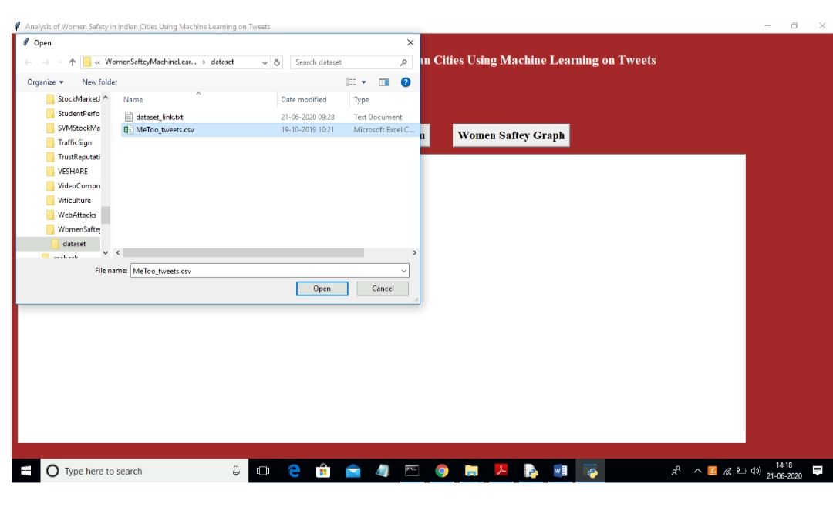

Slide 17
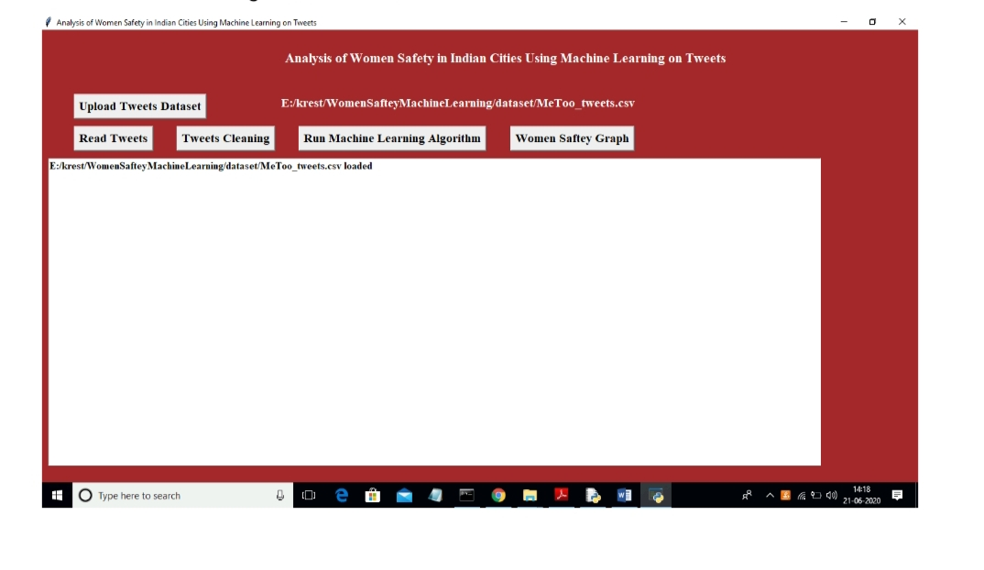

Slide 18
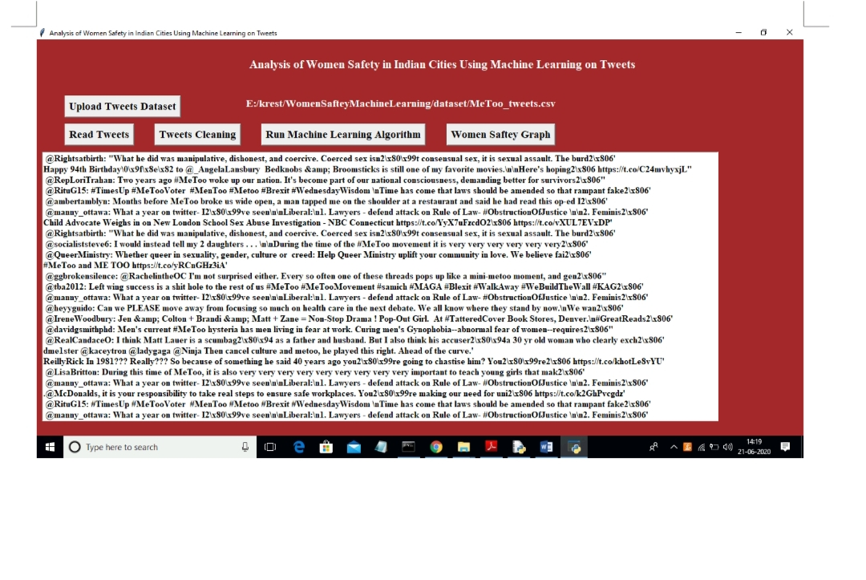

Slide 19
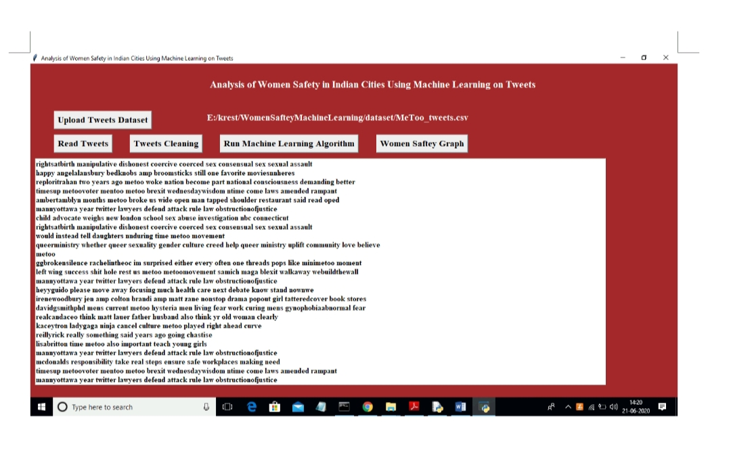

Slide 20
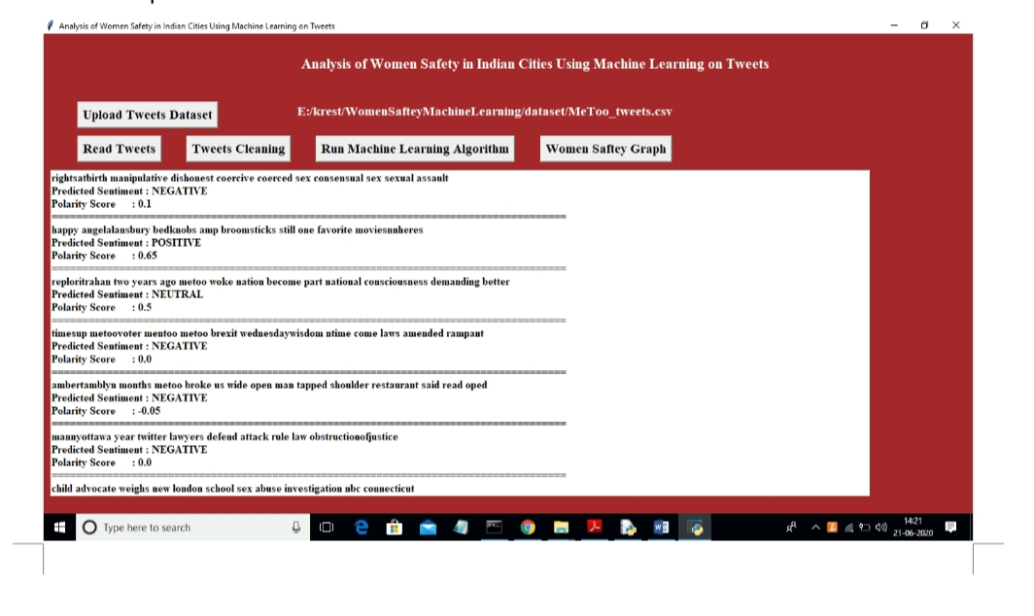

Slide 21
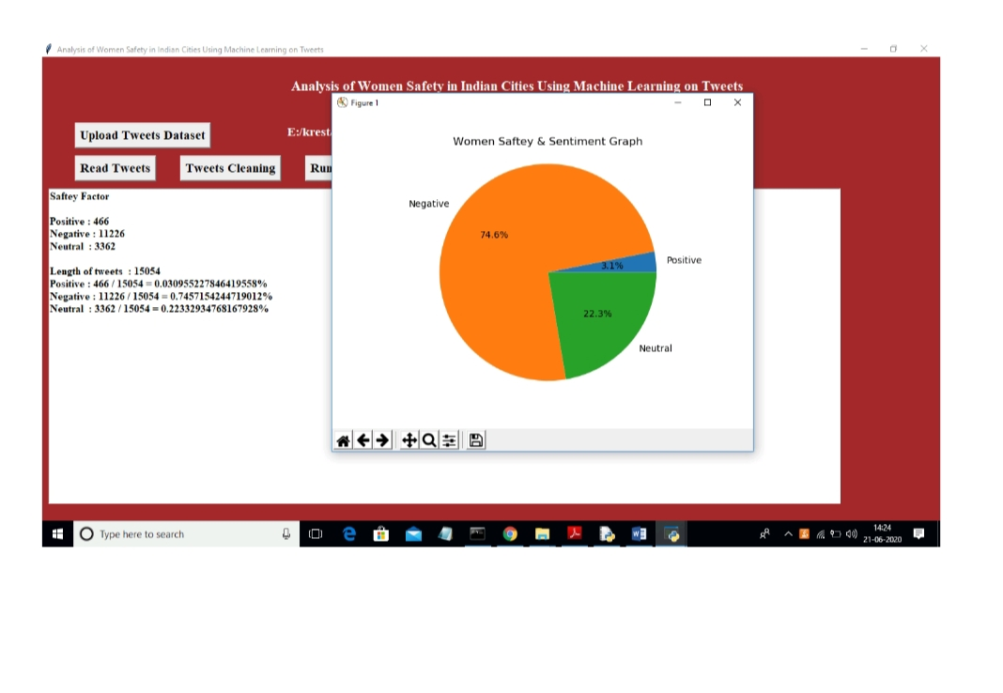

Slide 22
Conclusion
By using this NLP(Natural language processing) machine will analyze the twitter data and get an idea about the status of women safety in Indian cities. The efficiency of this NLP is more when compared with other data analyzing techniques.The efficiency of this NLP is 60% to 80%.
We will get the positive,negative and neutral percentages about the women status in our society in a bar graph.

Slide 23
Future Enhancement
In our present project we are analysing the status of women through twitter platform.Further we can improve this project by analysing the data from almost all the social media and In future we can process on an individual user who negatively comments on women .so that we can get the graph of that particular person along with it we can punish that person according to our electronic media laws if the percentage nagitivity of that person is very high.

Slide 24
References
[1]. Agarwal, Apoorv, FadiBiadsy, and Kathleen R. Mckeown. "Contextual phrase-level polarity analysis using lexical affect scoring and syntactic n-grams."Proceedings of the 12th Conference of the European Chapter of the Association for Computational Linguistics.Association for Computational Linguistics, 2009.
[2]. Barbosa, Luciano, and JunlanFeng. "Robust sentiment detection on twitter from biased and noisy data." Proceedings of the 23rd international conference on computational linguistics: posters. Association for Computational Linguistics, 2010.
[3]. Bermingham, Adam, and Alan F. Smeaton. "Classifying sentiment in microblogs: is brevity an advantage?."Proceedings of the 19th ACM international conference on Information and knowledge management.ACM, 2010.

Slide 25
Thank you!!

